Slide 1
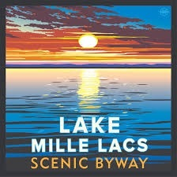
Love Our Byways Lake Mille Lacs Scenic Byway Tour

Slide 2
Lake Mille Lacs Scenic Byway Tour
Lake Mille Lacs Scenic Byway Bus Tour & Lunch was held September 29, 2021.
Nationally recognized folks shared what they know about tourism, archeology, geology and byway interpretation. Goals of the Day included: • Learning ways to communicate information about the Lake Mille Lacs Scenic Byway to its visitors • Learning the origins of the historical, natural, and cultural resources, objects, and sites, and how to show them in the most compelling ways • Connecting local byway enthusiasts while taking in the 68-mile route via tour bus • Enjoying a beautiful autumn day along Lake Mille Lacs

Slide 3
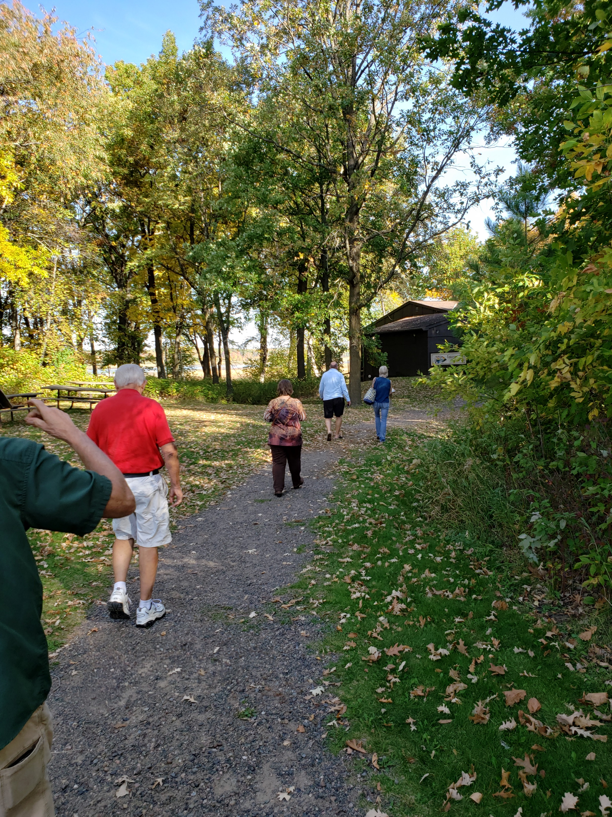
Mille Lacs Kathio State Park

Slide 4
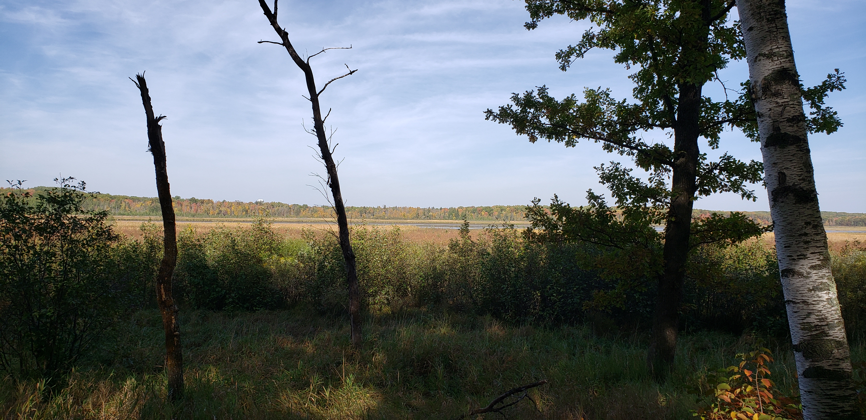
Mille Lacs Kathio State Park

Slide 5
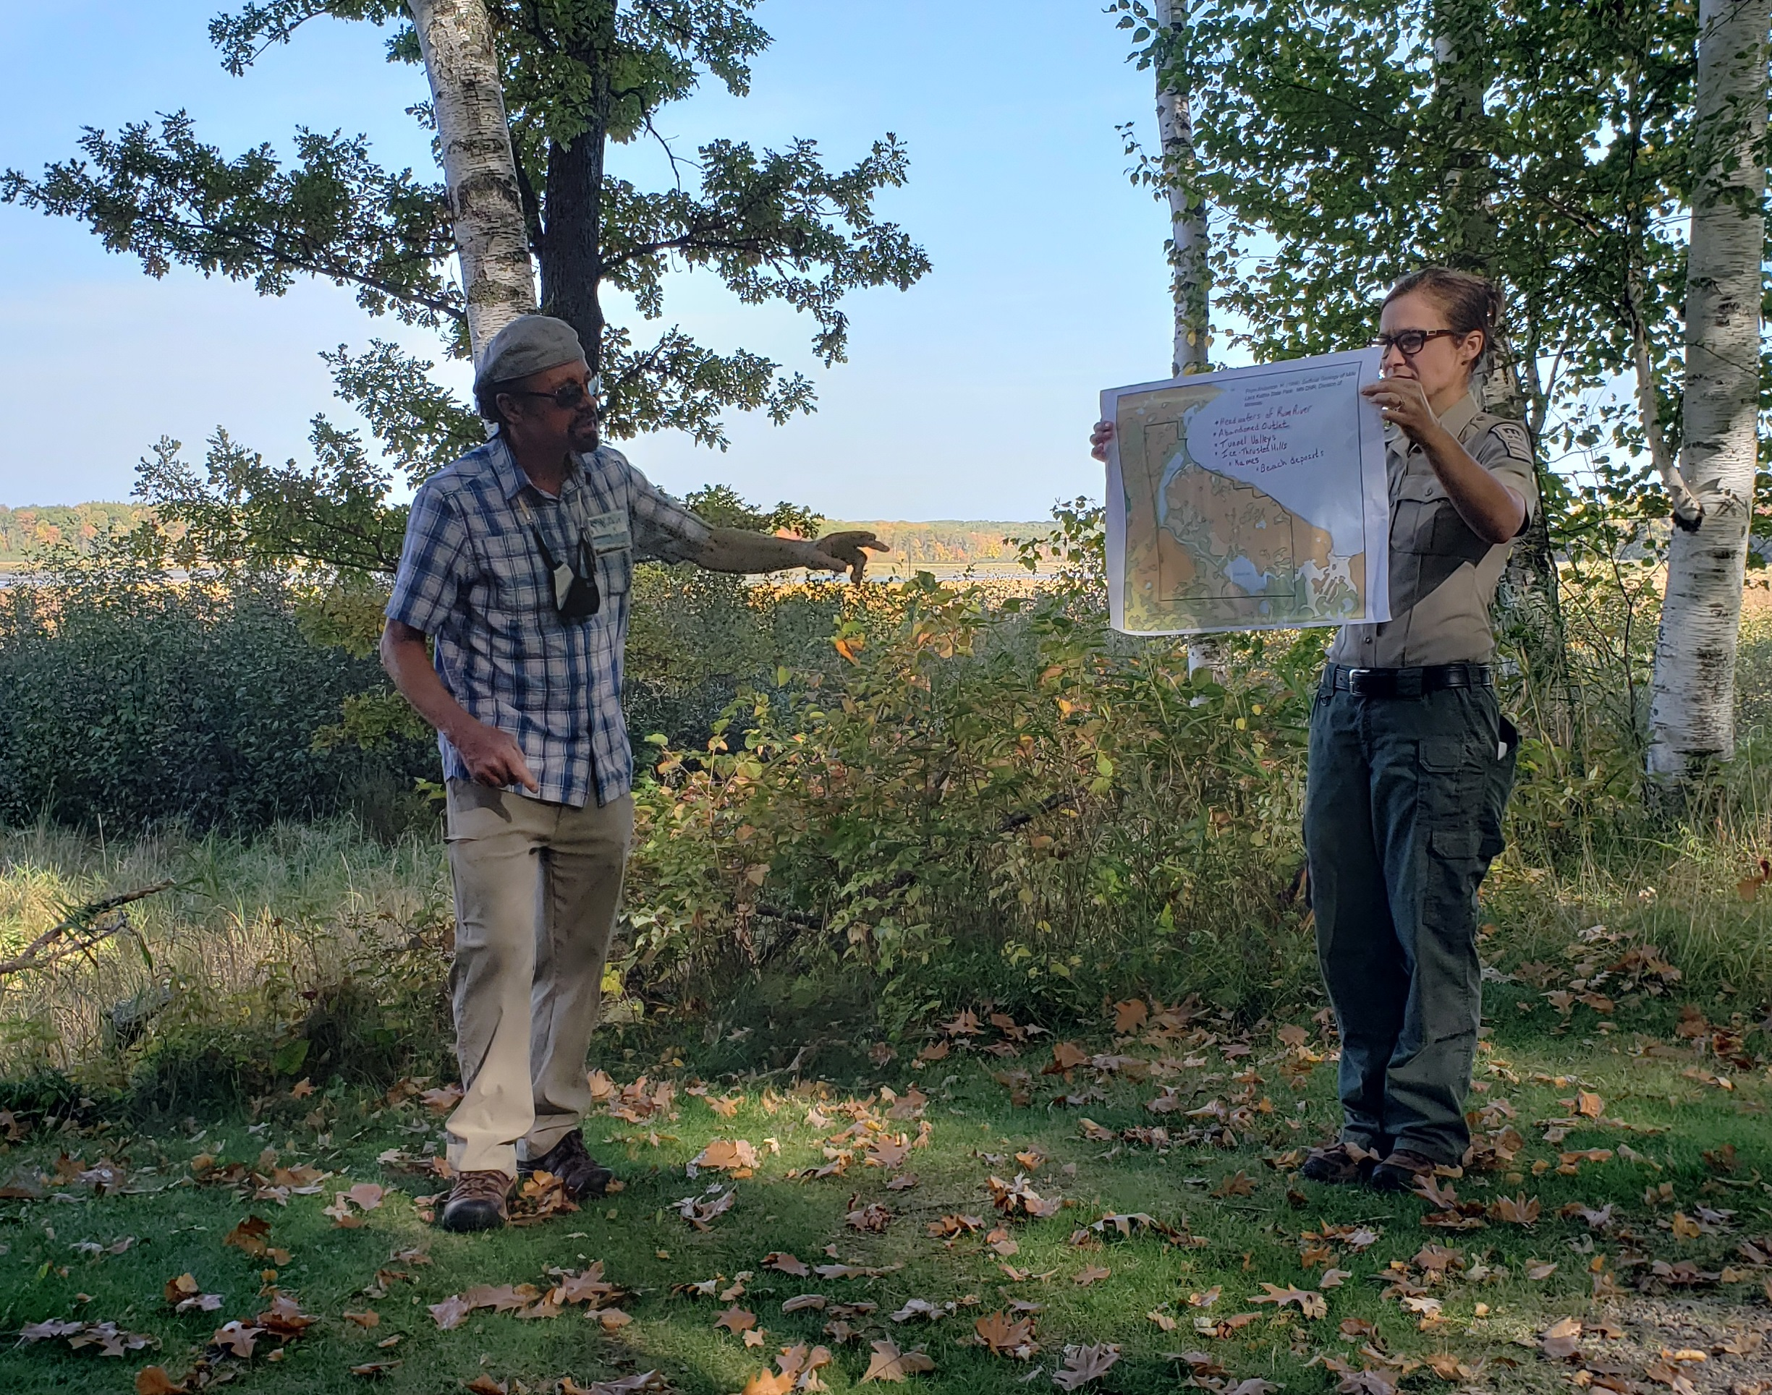
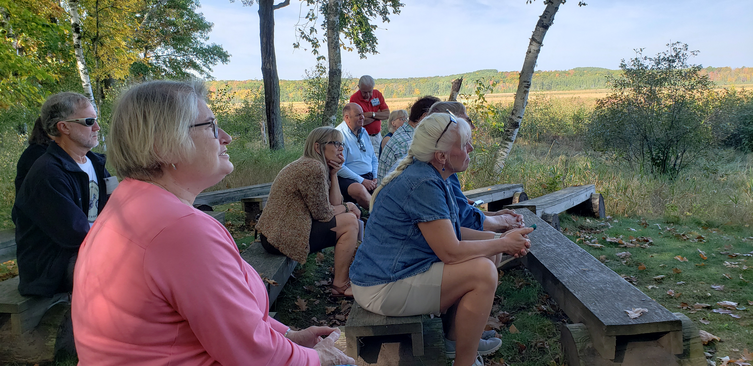
Mille Lacs Kathio State Park
Photo right: Presentation on Ogechie Lake natural history.
Photo above: Presentations on Wild Rice: demise, restoration and the homeland of the Dakota and Ojibwe.

Slide 6
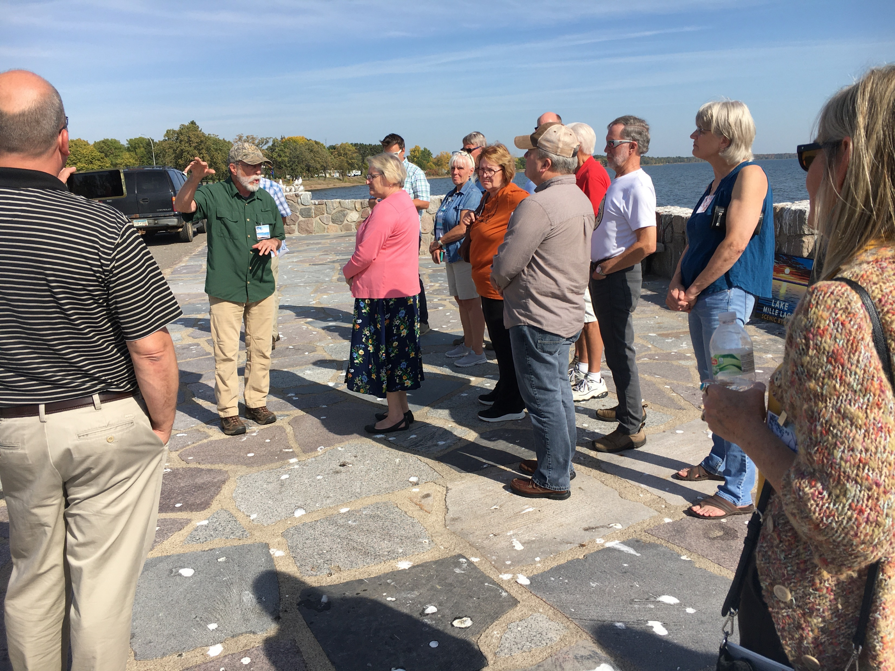
Garrison Concourse
Photos: presenter spoke on the history of the Civilian Conservation Corps (CCC) in the Garrison area and Lake Mille Lacs history

Slide 7
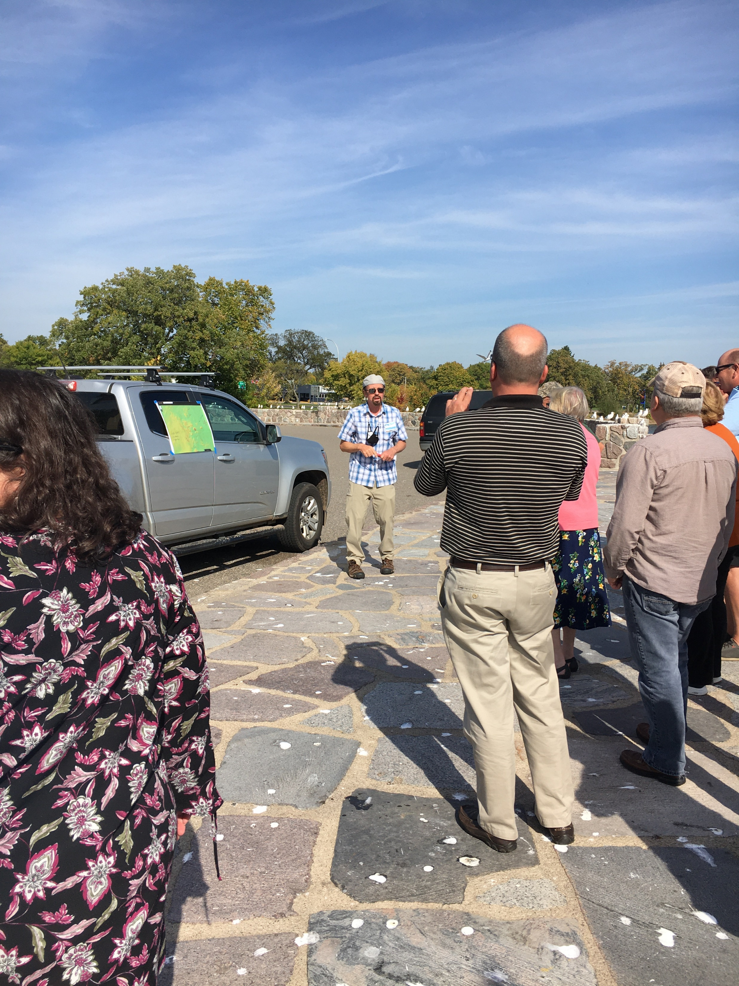
Garrison Concourse
Photos: Presentation about the Garrison archaeological sites.

Slide 8
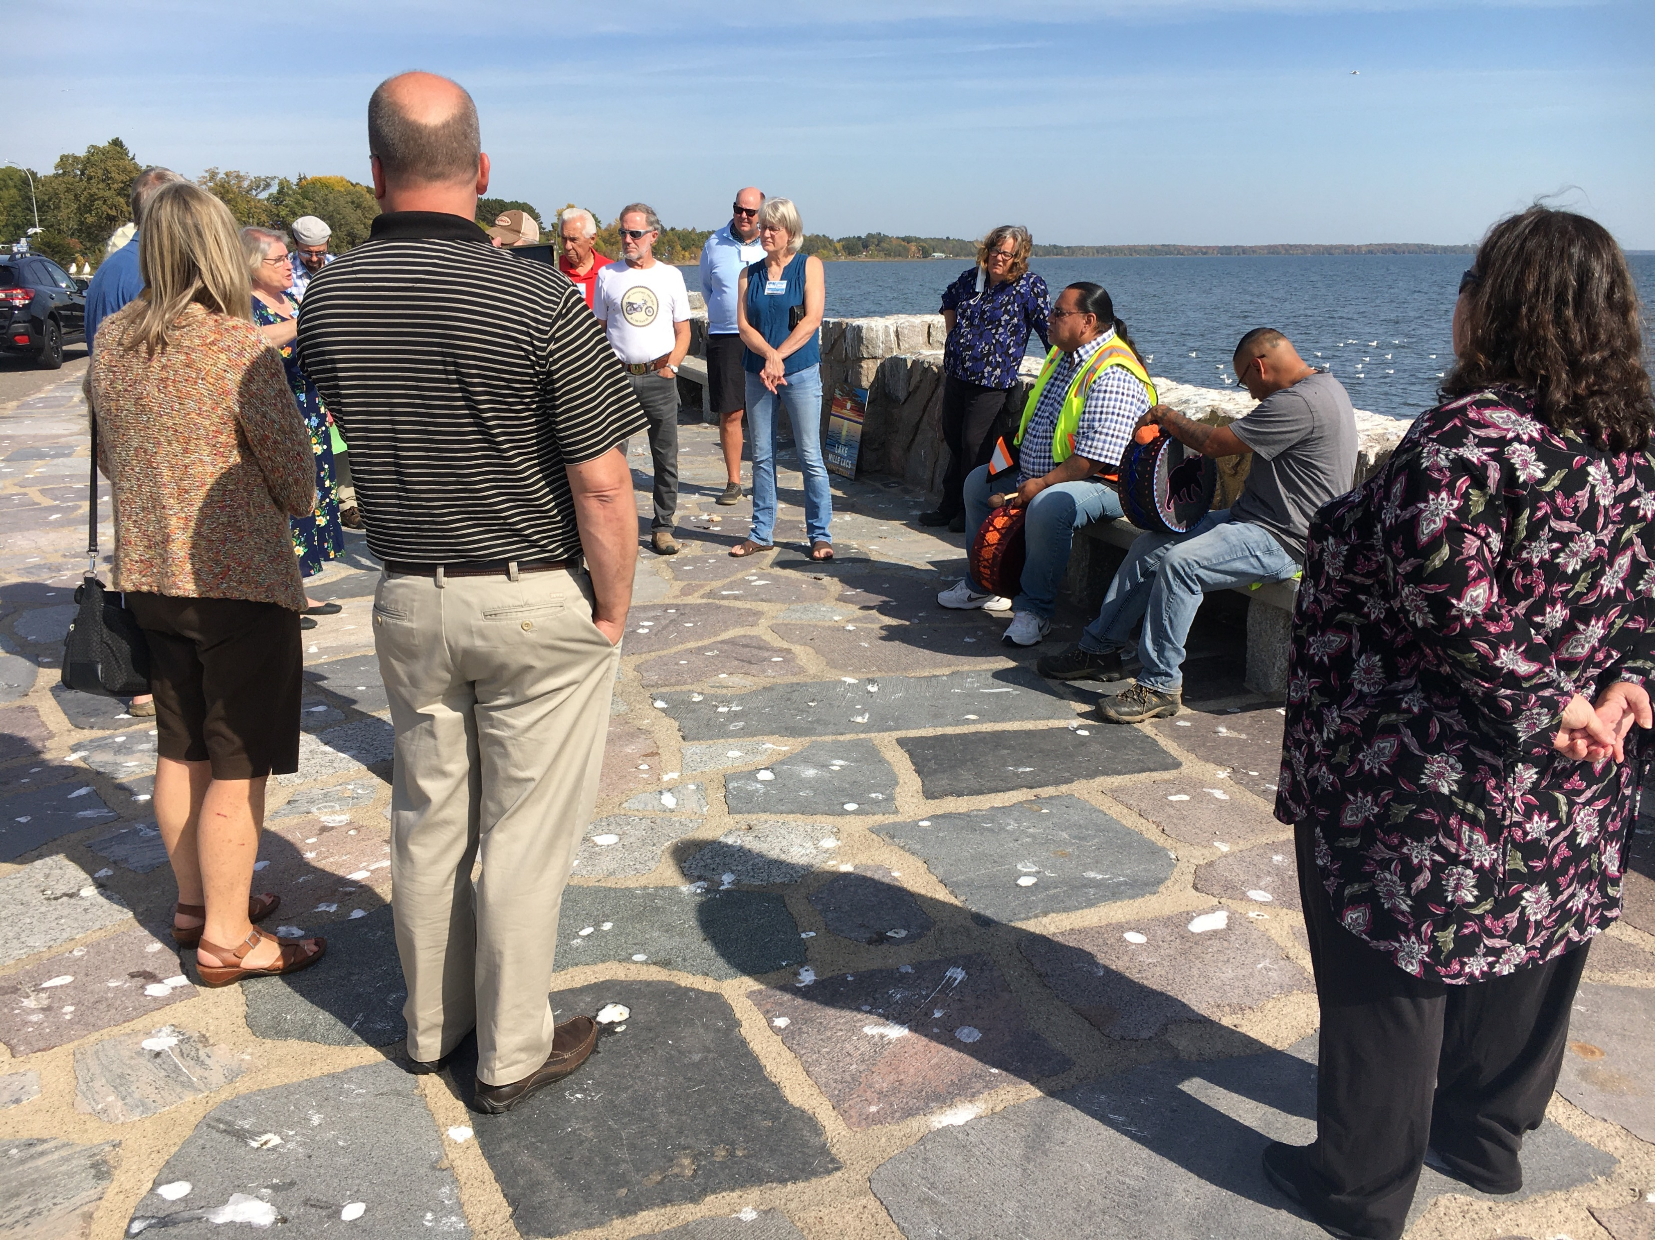
Garrison Concourse
Photo below: Native Americans gave presentation on the history of the Ojibwe and Dakota people.
Photo above: Native Americans sang a song for the group.

Slide 9
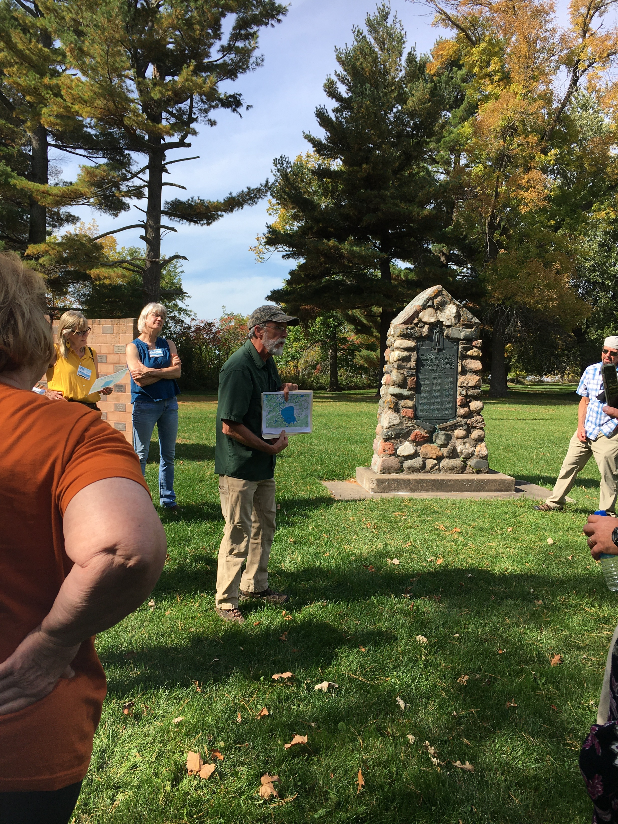
Malmo Memorial Park
Photos: Presentation on the history of the Malmo Memorial Park

Slide 10
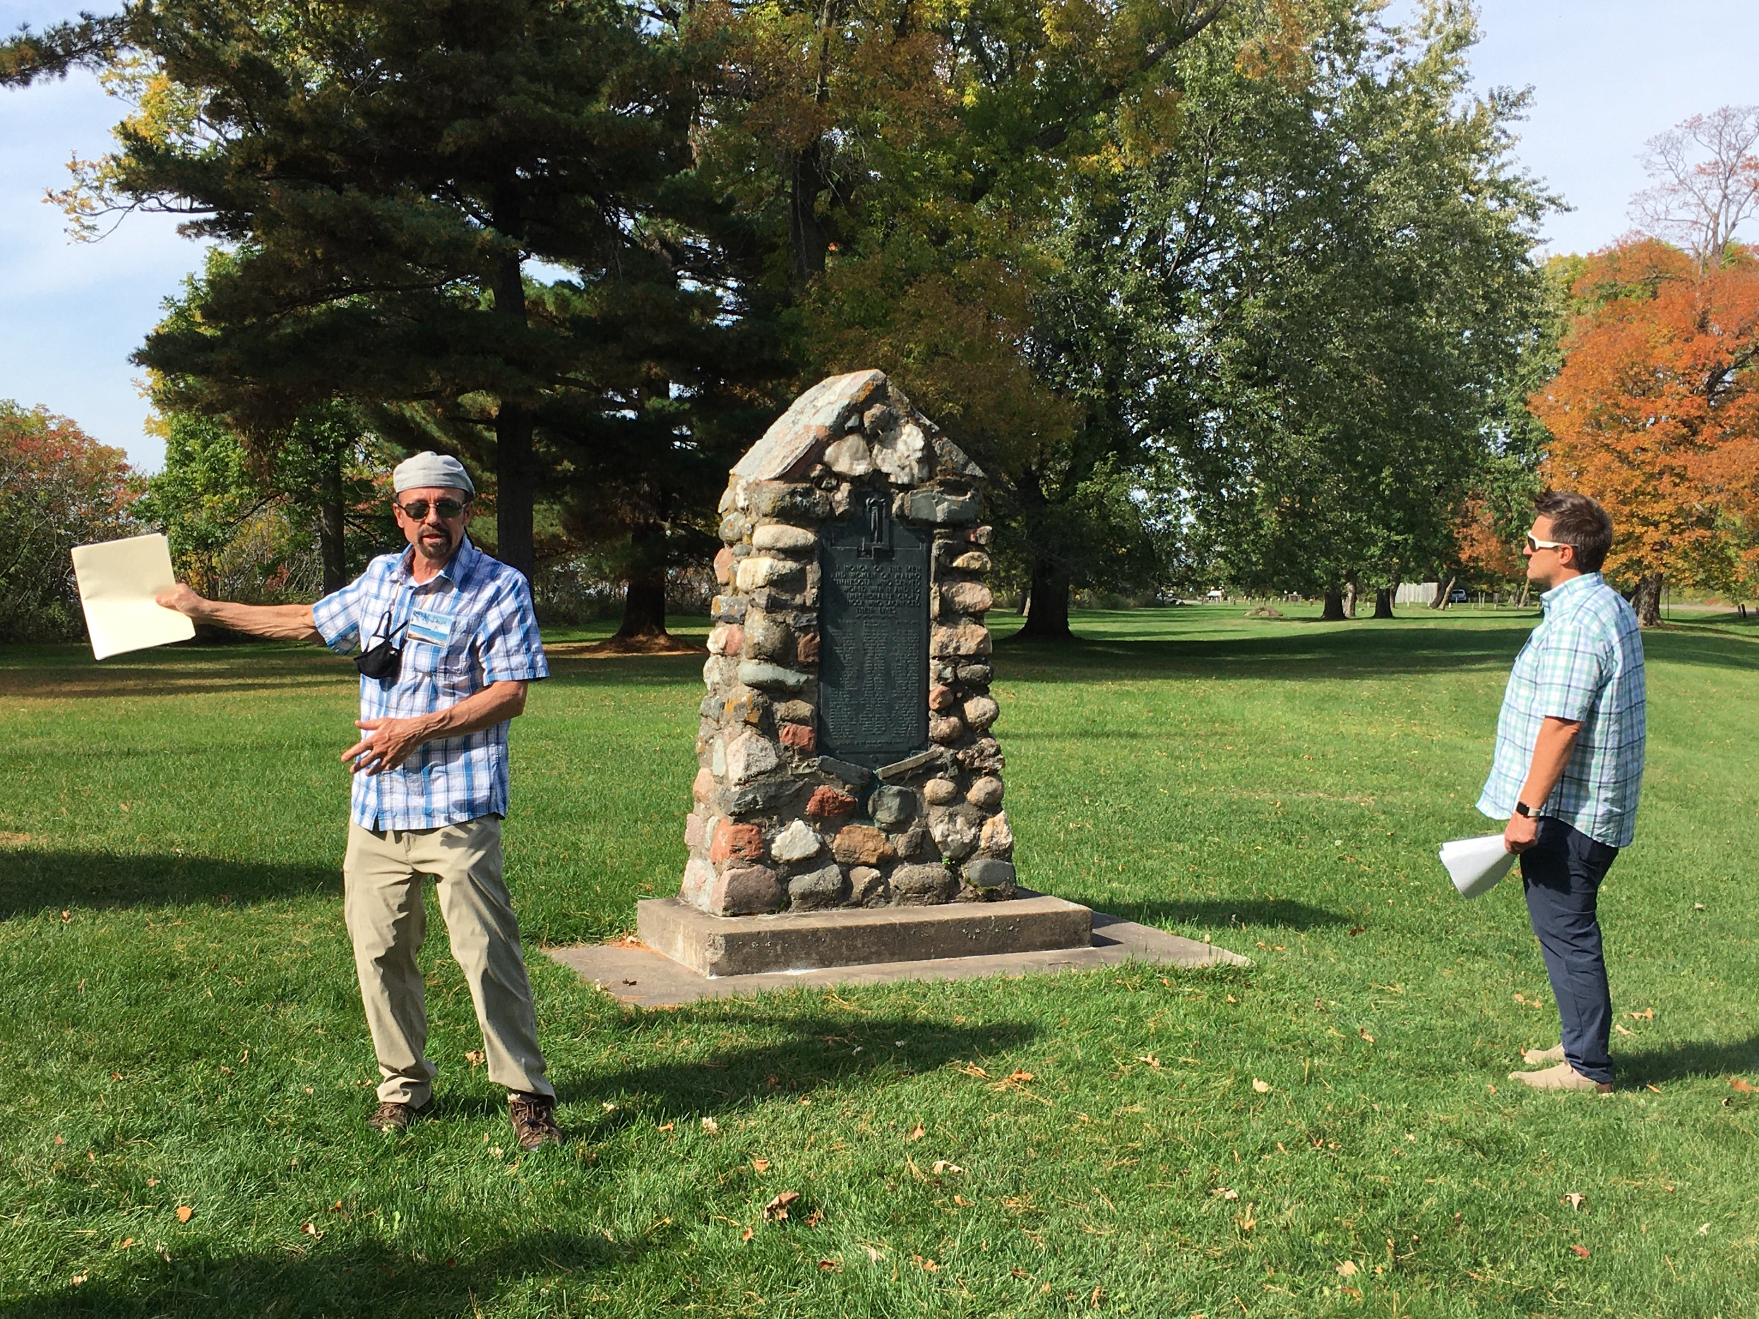
Malmo Memorial Park
Photos: Presentation pertaining to Malmo site 21AK1

Slide 11
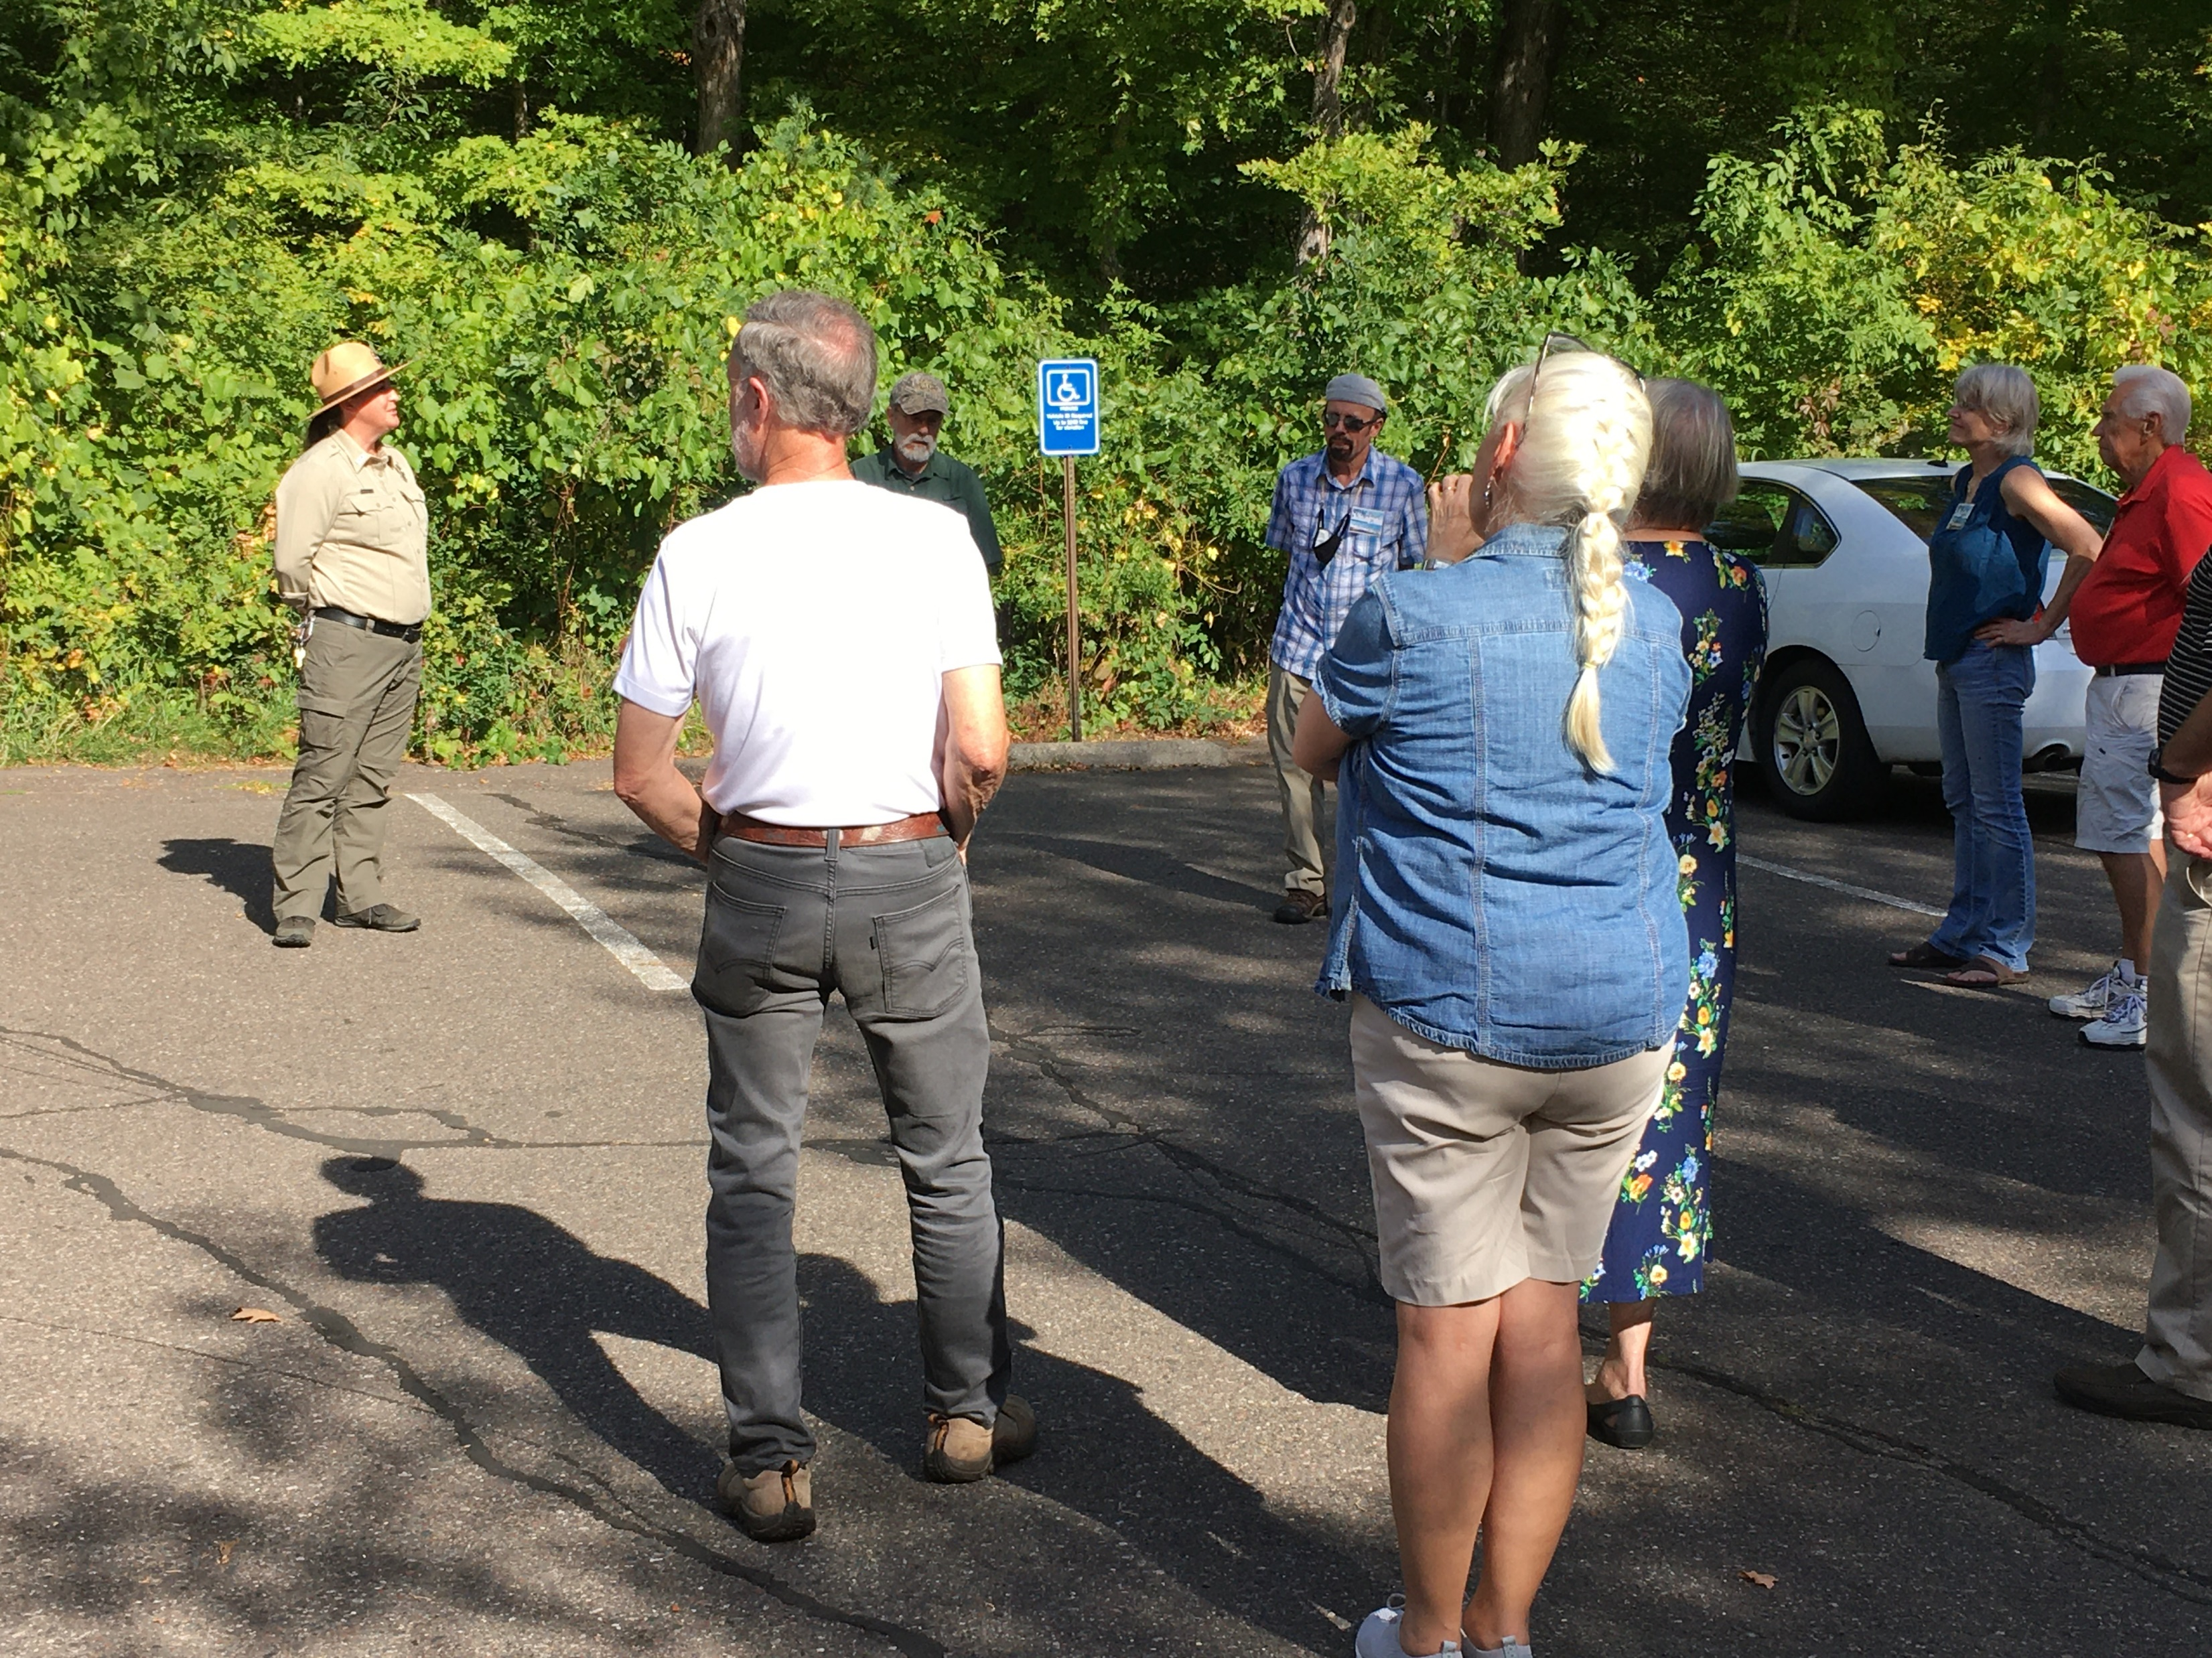
Father Hennepin State Park
Photos: Park Ranger gave presentation on Father Hennepin State Park

Slide 12
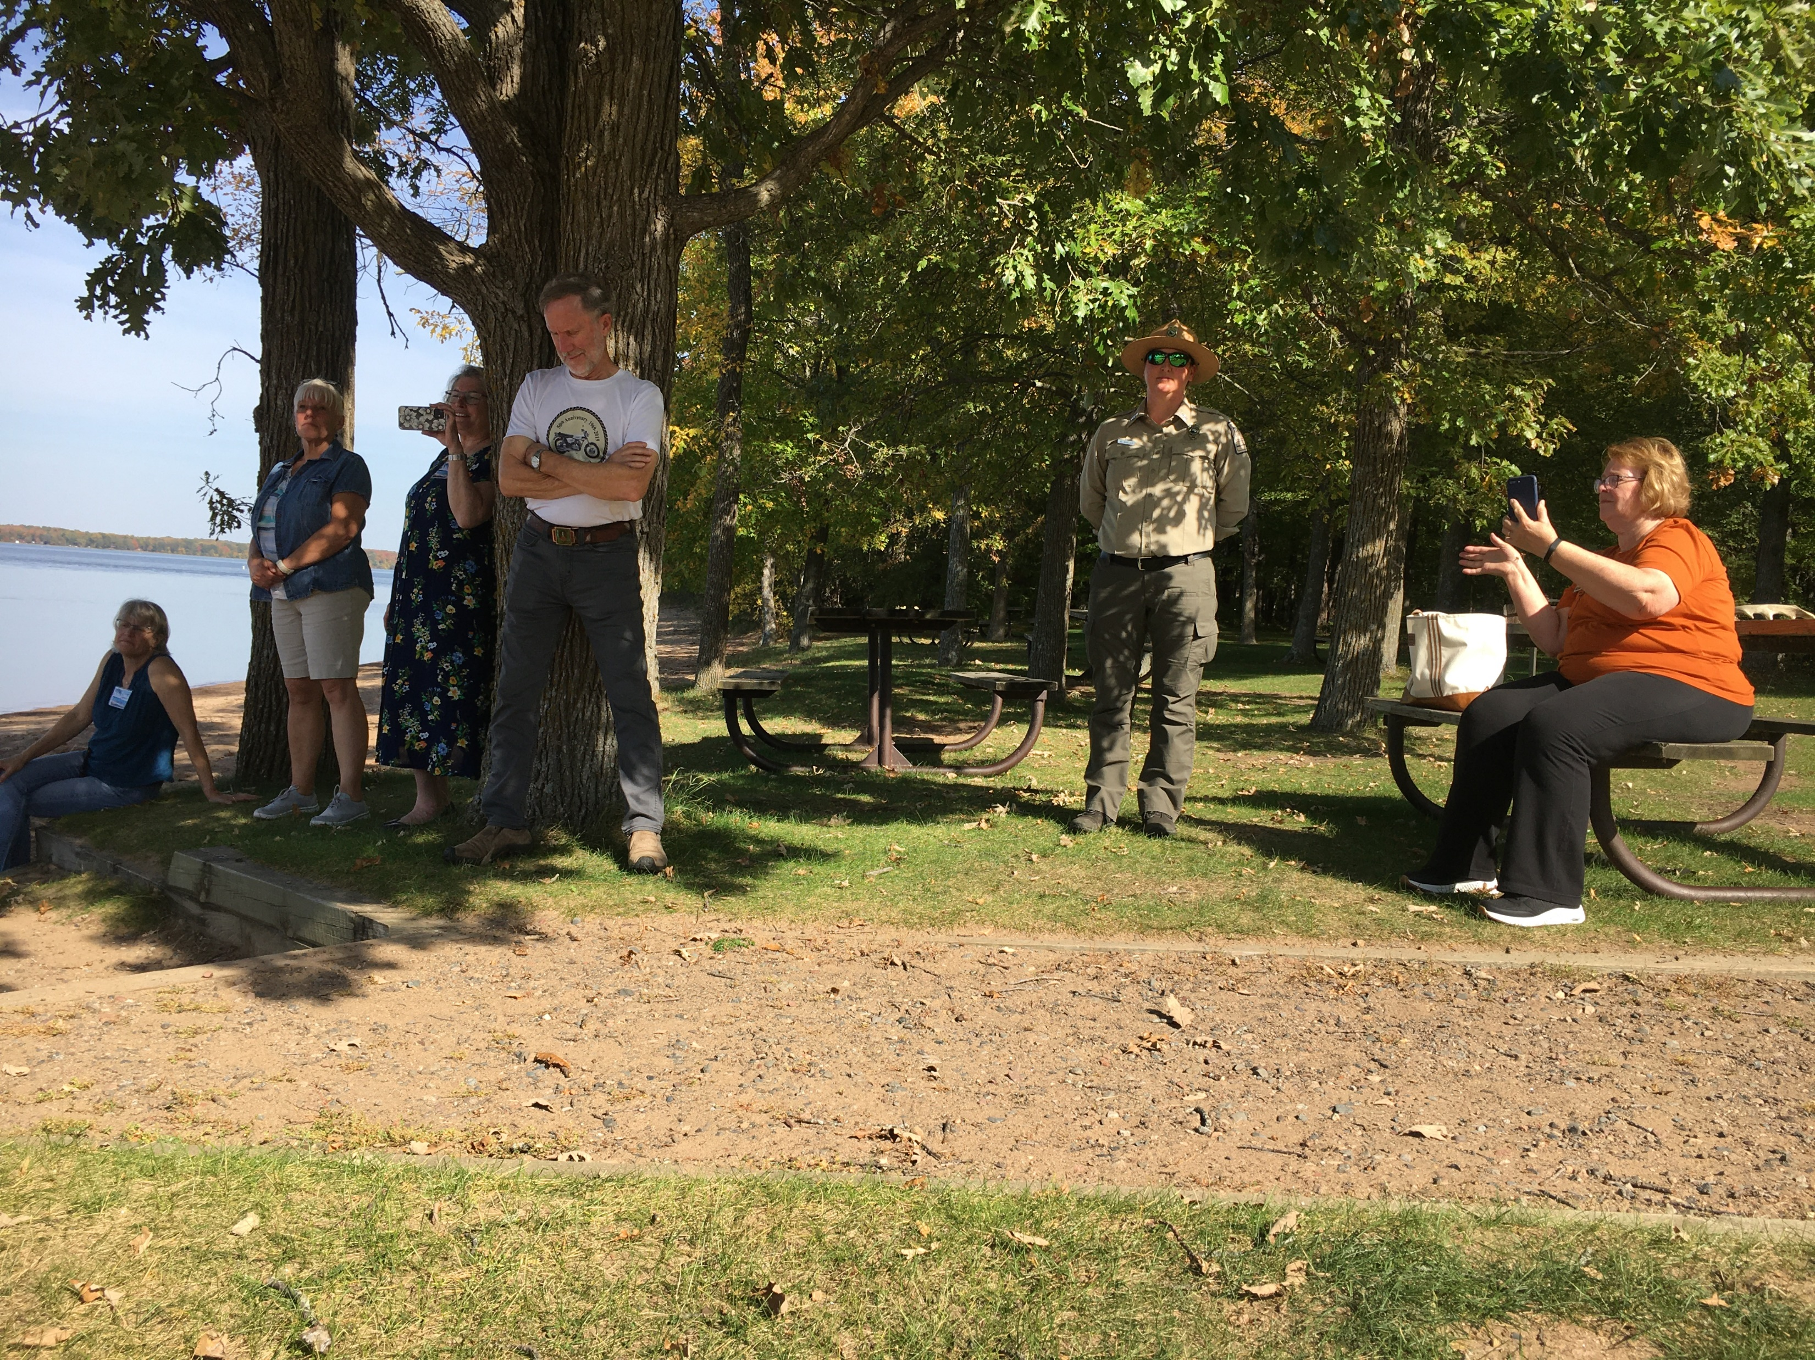
Father Hennepin State Park
Photo above: Presenter gave information about Father Hennepin Beach archaeological site

Slide 13
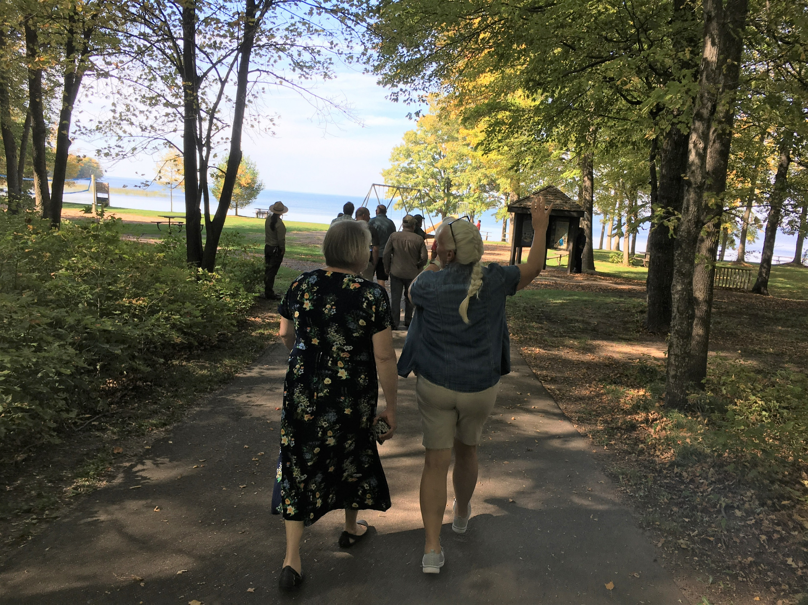
Father Hennepin State Park
Photo above: Presentation about the natural history of beach shoreline

